Slide 1


Principles & Practices of Open Research
An online module for undergraduate and Masters students

Slide 2

Getting Started with Open Research

Slide 3



Getting Started with Open Research: One Step at a Time
By taking this module, you have started your open research journey!
This section will take you through some next steps!

Slide 4



Learn More: Additional Resources
The Open Research Resources section of this course also includes open resource materials, websites and resources
Each resource is also accompanied by an explanation for why you might find it interesting
These resources have been chosen to complement your learning so far

Slide 5






Getting Started with Open Research
If you want to learn more about how to do open research you can take our follow-on modules
Research Integrity
Pre-registration
Research Data Management
Reproducible Practices
Open Reporting
Knowledge Dissemination
These will walk you through the steps of how to use each of these open research practices

Slide 6

Getting Started with Open Research: Additional Modules
Research Integrity
Pre-registration
Research Data Management
You can take the modules individually to get a sense of different aspects
Reproducible Practices
Open Reporting
Knowledge Dissemination
Or all together to get a full understanding of how to use open research practices

Slide 7





Use What You Have Learned
Start using what you have learned by evaluating the research you encounter every day from an open research perspective.
Was it conducted openly and transparently?
Can I trust the findings and where they came from?

Slide 8


Use What You Have Learned
Start using open research principles and practices in the research you are conducting or will conduct
We know it may not be possible to do it all of the open research practices, but using any of the practices is a great start!
Speak with your supervisor about using open research approaches in your current work

Slide 9




Getting Started with Open Research: Open Science Networks
You can set up your own network with fellow students
It can just be a place to come together and talk about open research
This doesn’t need to be a formal network

Slide 10

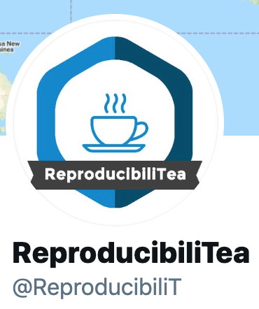





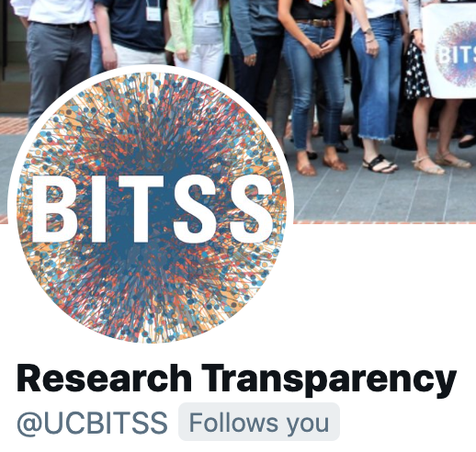

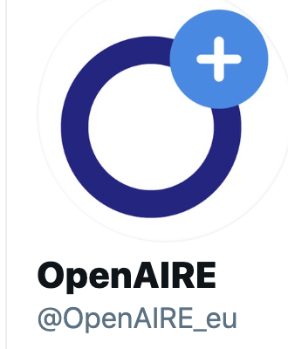

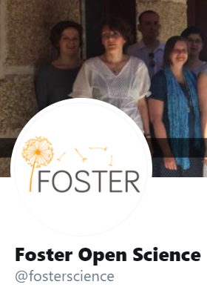

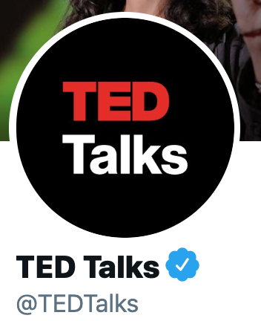
Getting Started with Open Research: Twitter Accounts to Follow

Slide 11

Getting Started with Open Research: Additional Modules
Research Integrity
Pre-registration
Research Data Management
Don’t forget that you can take any/all of our follow-on modules to learn more about how to do open research
Reproducible Practices
Open Reporting
Knowledge Dissemination

Slide 12
Activity
Read the open research article on Canvas and reflect on the open research practices used, and how you could include these in a research project

Slide 13


